Slide 1
Security Challenges in the Industrial Revolution 4.0 (IR 4.0)
NetSec Group Member:
WQD180122 Nur Afiqah Zainol Abidin
WQD180079 Sidratul Muntaha
WQD180119 Lee Zhao Wei
Lecturer: Dr. Saaidal Razalli Bin Azzuhri

Slide 2
Presentation Outline
Introduction
Literature Review
Methodology
Results & Conclusion
Project purpose
Problem statements
Objectives
CPS & IoT
Challenges
Components
Importance of security
Expected Outcome
Conclusion

Slide 3
Introduction
Industry Revolution 4.0 (IR4.0) was introduced by German scholar.
Automation, interoperable & interrelated production and product development life cycle.
Cyber physical production system (CPPS): Integrate and join various automated devices such as;
robotics, automation, cloud computing, big data, AI, IoT, augmented reality.
Interrelating every devices and use of standard communication protocols in IR4.0 are in great demand.
Purpose: demonstrate the security risks and challenges of IR 4.0 and to deliver ideas that can ensure reliability and security of automation sectors.
Notes:
GERMAN SCHOLAR
THIS CONVERSION FACILITATES INDUSTRIES WITH: automation…..
CYBER PHYSICAL PRODUCTION SYSTEM (CPPS) THAT INTEGRATES AND JOIN VARIOUS OF CURRENT AUTOMATED DEVICES SUCH AS: robotics….
The need of interrelating every devices and use of standard communication protocols in IR4.0 are posing great demands to protect critical industrial systems and manufacturing lines from cybersecurity threats that has been growing dramatically.
AS A RESULT, SECURE AND RELIABLE COMMUNICATION AND AUTHENTIC IDENTITY ARE INDISPENSABLE.
ENGINEERS DOES NOT POSSESS STANDARDIZED METHOD FOR CONSIDERING SECURITY AND PROTECTION REQUIREMENT AT EARLY STAGE DESIGN.

Slide 4
Introduction
Lack of standardized method in considering security and protection requirements of industrial system.
Ensure reliability of the CPS devices.
Problem Statement
To discuss the increasing security risks and challenges of IR4.0.
To find a standardized architecture that acknowledges the reliability and security of the CPS devices at an early stage of system design.
Objectives
Notes:
standard guide for cybersecurity: ISO, NIST, OWASP.

Slide 5
Literature Review
Devices in the Internet of Things (IoT) generate, process, and exchange vast amounts of security and safety-critical data as well as privacy-sensitive information, and hence are appealing targets of various attacks.
Cyber Physical Systems (CPS) are automated systems that enable connection of the operations of the physical reality with computing and communication infrastructures.
It aims to monitor the behavior of physical processes and execute actions to modify its behavior so that physical environment can work correctly and better.
The physical process is monitored or controlled by the system which is the networked system of several tiny devices with sensing, computing and communication capabilities

Slide 6
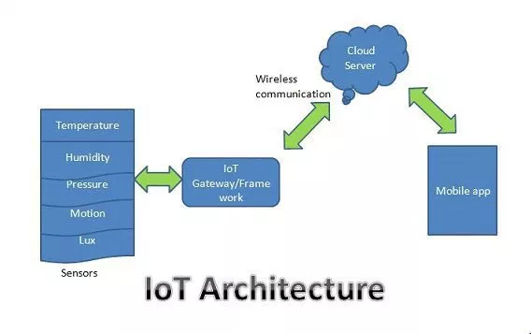
Basic Understanding of IoT

Slide 7
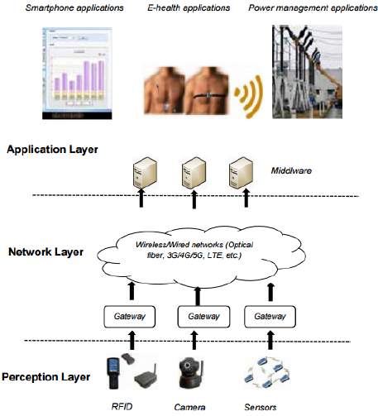
Three layer of IoT

Slide 8
Security Challenges in Each layer of IoT
Perception Layer | Network Layer | Application Layer
Strength of Wireless signals | heterogeneity of the network components makes it difficult to use the current network protocols | Different applications have different authentication mechanisms, integration of all of them very difficult
Sensor node in IoT devices can be intercepted | Highly susceptible to Man-in-the-Middle attack
Inherent nature of network topology which is dynamic | Machine-to-machine communication that the IoT introduces has a security issue of Compatibility.

Slide 9
Why it is difficult to have secure network within IoT
In the past, systematic integration of countermeasures against cyberattacks often followed integration of IT components with some delay.
The security challenges with IoT is the heterogenous and large scale objects and networks.
Huge number of devices as is but now add in a massive level of complexity with most of these devices being very different from each other with regards to operating systems, memory and harware.
Most IoT Devices Weren’t Designed to be Upgraded.
Devices are connected to the internet all the time.

Slide 10
Cases of security flaw of in IoT
Mirai Botnet
Mirai is IoT specialized malware that uses common usernames and passwords to gain access to IoT devices. For example, IP cameras, monitors, and loggers running Linux may have default credentials such as “admin” and “password,” allowing the malware to easily access the system, install itself, and then turn the IoT device into a bot. While individual IoT devices cannot perform much of an attack, the combination of millions of simple devices allows the collection of bots – called botnet – to perform distributed denial of service (DDoS) attacks on major networks.
One noticeable attack occurred on October 21st, 2016, when the Mirai botnet attacked Dyn, a company that provides domain name services to major companies including Netflix, GitHub, Twitter, and Reddit.
Mirai perfectly demonstrates how designers of IoT devices with integrated, publicly available software must recognize that default login credentials should be changed and can be potentially abused for serious attacks.

Slide 11
Challenges to propose secure network:
one of the major challenges of Industrial revolution is that the industries are converging with information technology , But the way IT gets updated and upgraded in a very short circles ,OT can not do that. OT projects that include CPS, IoT like devices require budget, planning and longevity.
The transformation of factories to smart factories need smart people as well , so the workers need practical and clear knowledge about technologies.
Another important factor is cost estimation for security sectors. Financial barriers are the components that can no be ignored . So , the manufacturers tend to overlook the security aspect while building the devices.
The CIA triangle varies among different kinds of factories. For example: for electric company availability is more important but for a financial company confidentiality and integrity is more of a priority.

Slide 12
Recommendation
Establishing set of policies and legalizing them for ensuring Data integrity and confidentiality in the industries.
For Protecting copyright issues and sensitive data of machines and production systems necessary measures should be taken like cryptography for copyright issues and coupling machines upon necessity only can reduce the risk.
Security should be initiated in the early stages of system design, which can save the company from redesigning , costing and time.
self maintenance for upgrading the devices can be introduced and the devices can give error report and feedback when needed.
vocational training should be provided among the workers so that they can have sound knowledge about the technology and work as such.

Slide 13
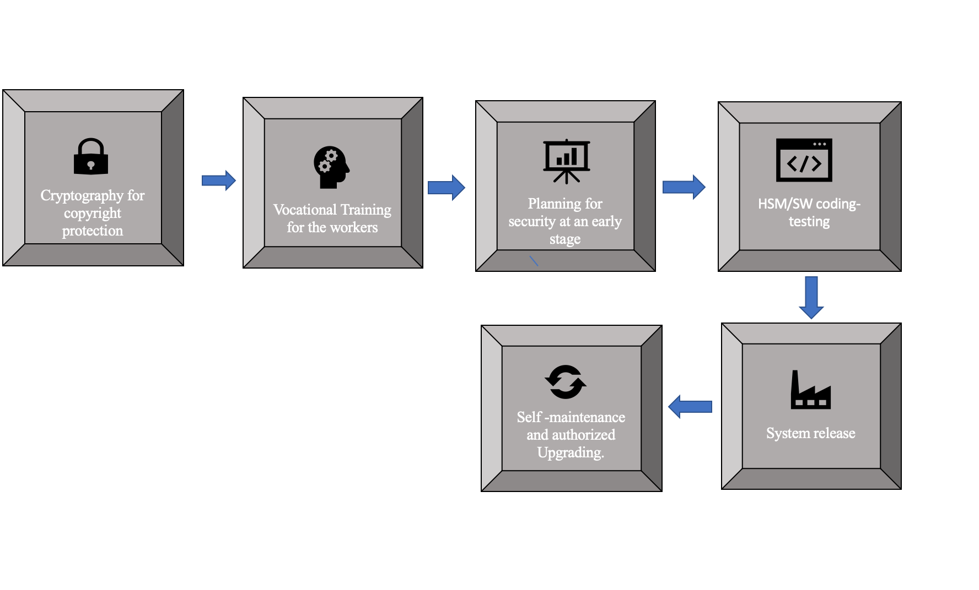
Recommendation (continue)
Fig.1:Security measures for IR 4.0

Slide 14
Conclusion
Security in industrial revolution 4.0 is the most talked issue of the decade, considering the exploding complexity of the emerging technologies, which creates possibilities of attack surface that did not exist before. In a general way, what before could be protected with walls and physical security, now requires a matching level of sophistication and management.
In order to ensure a safe and protected environment in I4.0,the security management is of utmost important. And it should be implemented with proper planning, deployment and operational cycle.

Slide 15
Question & Answer….
Thank You
All The Best for final ☺

